Slide 1
Government and taxes
2012
Mária Adorján

Slide 2
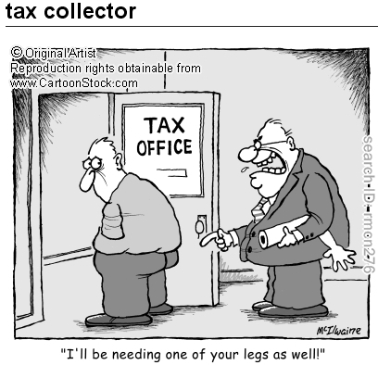
Taxes
To tax is to impose a financial charge or other levy upon a taxpayer (an individual or legal entity) by a state or the functional equivalent of a state (e.g. municipality).
For more: http://en.wikipedia.org/wiki/Tax#The_Four_.22R.22s

Slide 3
Purposes and effects: (the 4 ’R’s)
Revenue collection: to spend on armies, roads, schools and hospitals …
Redistribution: transferring wealth from the richer sections of society to poorer sections.
Repricing: for example, tobacco is taxed to discourage smoking, and a carbon tax discourages use of carbon-based fuels.
Representation: rulers tax citizens, and citizens demand accountability from their rulers.

Slide 4
Tax expressions
A tax levied by the government on excess company profits
to raise /cut taxes, tax increases / cuts
changes in tax rates (%)
flat rate: the same for every situation
to pay over £1000 in tax
Income tax will be deducted by your employer.
tax avoidance: ways of paying only the smallest amount of tax you legally have to
tax evasion: the crime of deliberately not paying all the taxes that you should pay
tax exempt: that is not taxed (e.g. tax exempt savings)
tax brackets: ranges of different incomes on which the same rate of tax must be paid There are now only two tax brackets – 22% and 40%.
tax haven: a place where taxes are low and where people choose to live or officially register their company
Offshore company: company located in a tax haven

Slide 5
Taxes on income
Income tax for individuals
Capital gains tax (2010)
  Individuals pay 25% for capital gains and other investment income.
  20% tax rate is paid on capital gains from sale of shares in EU and OECD markets.
  Dividend income from shares in EU stock exchanges is taxed at 10%.
  Interest income is taxed at 20%.
Corporate tax for companies

Slide 6
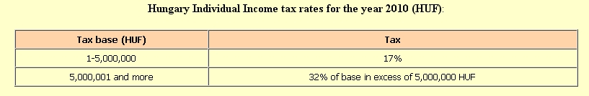
Progressive income tax
2010: progressive tax is a tax by which the tax rate increases as the taxable base amount increases. (The higher the income, the higher the rate of tax payable)
http://www.worldwide-tax.com/hungary/hungary_tax.asp

Slide 7
Flat rate personal income tax
2011: The Hungarian parliament has approved the government’s 2011 tax bill, which introduces a flat rate personal income tax of 16%, and grants a 10% corporate tax rate to certain companies from next year.
Hungary’s 2011 tax bill, which was adopted by 259 votes to 104, provides for a 16% flat rate of personal income tax in a bid to boost domestic demand. It also reduces the corporate tax rate from 19% to 10% for all companies from January 1, 2013. http://www.tax-news.com/news/Hungarian_Parliament_Approves_2011_Tax_Bill____46438.html

Slide 8
2012?
Personal income tax: flat or progressive in 2012?

Slide 9
Types of payment
1. Payment by time (időbér)
Payment by time is the type of payment in which the employee is paid according to the real working time at the company:
• Monthly / Weekly / Daily /Hourly
2. Payment by results (or by products) (teljesítménybér)
Payment by results is the type of payment in which the employee is paid based on the number and quality of the product he (or she) produced.
3. Payment by work:
This is the type of payment in which the employee is paid according to the amount and quality of work he (or she) is required to do.

Slide 10
Minimum wages in Hungary, 2011
A teljes munkaidőben foglalkoztatott munkavállaló részére megállapított személyi alapbér kötelező legkisebb összege (minimálbér):
a teljes munkaidő teljesítése esetén 2011. január 1-jétől havibér alkalmazása esetén 78 000 forint,
hetibér alkalmazása esetén 17 950 forint,
napibér alkalmazása esetén 3 590 forint,
órabér alkalmazása esetén 449 forint.
A fenti bekezdésben meghatározottaktól eltérően a legalább középfokú iskolai végzettséget, illetőleg középfokú szakképzettséget igénylő munkakörben foglalkoztatott munkavállaló garantált bérminimuma
a teljes munkaidő teljesítése esetén 2011. január 1-jétől havibér alkalmazása esetén 94 000 forint,
hetibér alkalmazása esetén 21 650 forint,
napibér alkalmazása esetén 4 330 forint,
órabér alkalmazása esetén 541 forint.
A fenti információ kivonata a 337/2010. (XII. 27.) Korm. rendeletnek.

Slide 11
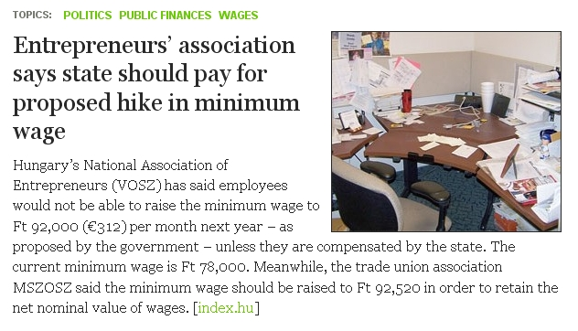
Minimum wage

Slide 12
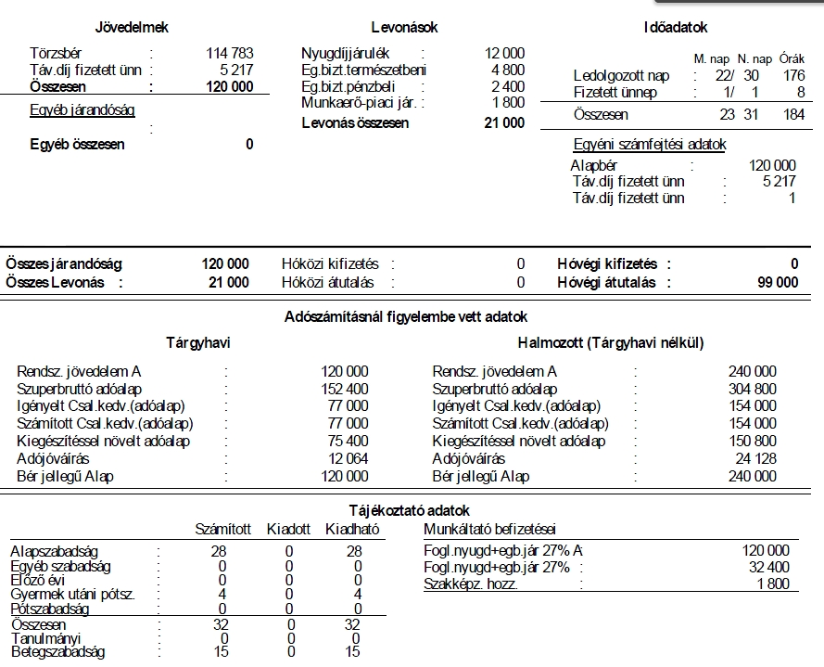
Gross or net salary?
Sample Payment Record 2011 March

Slide 13
Bérkalkulátor 2012 http://www.nettober.com/index.php?p=berkalk20120101
Munkavállalót terhelő költségek
Nyugdíjjárulék 10%
Egészs. Bizt. 7%
Munkavállalói jár. 1,5%
Munkaadót terhelő költségek
Nyugdíjjárulék 24%
Munkaadói járulék 3%
Szakképzési hozzájárulás 1,5%

Slide 14
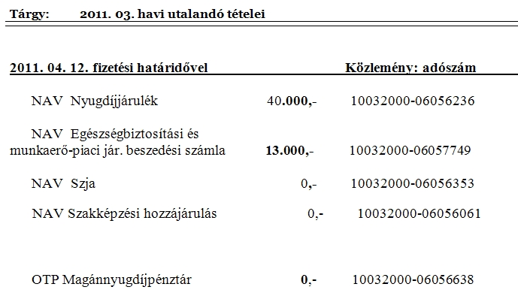
Social contribution and tax types

Slide 15
Social security contributions
Official information for Hungarians:
https://ugyintezes.magyarorszag.hu/cimkek?cimke=403274
Employers are required to make social contributions of 28.5% of an employee’s gross wages.

Slide 16
Useful websites
jobseekers in the EU
http://ec.europa.eu/youreurope/citizens/work/jobseeker/faq/index_en.htm#faq-09
adókalkulátor gross/ net
http://www.portfolio.hu/gazdasag/adozas/
http://www.nettober.com/
electronic tax form LEARN TO FILL IN YOUR OWN TAX FORM! EASY!
https://segitseg.magyarorszag.hu/etananyag/nyomtatvanykitoltes.html
same in video
https://segitseg.magyarorszag.hu/etananyag/nyomtatvanykitoltes.html?videotananyag

Slide 17
Taxes on property
Property tax
Inheritance tax
Wealth tax
In Hungary wealth tax must be paid on watercrafts, aircrafts and high performance – with a performance of 125 kW or more – passenger cars listed in the Hungarian official registers.
Municipalities in Hungary also levy local tax, building and building site taxes.

Slide 18
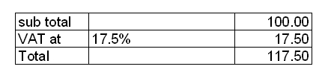
Taxes on goods and services
Value added tax
http://www.tmf-vat.com/vat/eu-vat-rates.html
Hungarian VAT Rate (2011)
Standard Rate 25%
Reduced Rate 18%; 5%
The Hungarian government has today announced plans to increase its standard VAT rate by 2%, from 25% to 27%. http://www.tmf-vat.com/tmf-in-the-media/hungary-increases-vat-2-to-27.html
(2012?)
German VAT Rate
Standard Rate 19%
Reduced Rate 7%
Spanish VAT Rate
Standard Rate 18%
Reduced Rates 4%, 8%
Sales taxes http://www.tax-news.com/news/Hungary_Adopts_Hamburger_Tax____50476.html
Hungary Adopts 'Hamburger Tax'
Eager to generate additional tax revenues and to reverse increasingly unhealthy dietary trends, the Hungarian parliament has recently voted in favour of a new tax on unhealthy foodstuffs. Dubbed the ‘hamburger tax’ and primarily targeting biscuits, energy drinks and pre-wrapped cakes, the new levy is to be imposed on food and drink in Hungary with a high sugar, salt, caffeine, or carbohydrate content from September 1.
Excise duty/tax (jövedéki adó, a jövedéki adót a termelő, a fogyasztói adót a végső felhasználó fizeti ki) (see more on US usage - websearch)
Excise tax on wine, tobacco, gasoline etc.

Slide 19
VAT http://en.wikipedia.org/wiki/Value_added_tax
A Value Added Tax (VAT) is a form of consumption tax. From the perspective of the buyer, it is a tax on the purchase price. From that of the seller, it is a tax only on the "value added" to a product, material or service, from an accounting point of view, by this stage of its manufacture or distribution. The manufacturer remits to the government the difference between these two amounts, and retains the rest for themselves to offset the taxes they had previously paid on the inputs.
The " value added " to a product by a business is the sale price charged to its customer, minus the cost of materials and other taxable inputs. A VAT is like a sales tax in that ultimately only the end consumer is taxed. It differs from the sales tax in that, with the latter, the tax is collected and remitted to the government only once, at the point of purchase by the end consumer. With the VAT, collections, remittances to the government, and credits for taxes already paid occur each time a business in the supply chain purchases products.
Personal end-consumers of products and services cannot recover VAT on purchases, but businesses are able to recover VAT (input tax) on the products and services that they buy.

Slide 20
Tariff, duty http://www.bangkoklogistics.com/free-trade-agreement/tariff/Tariff-Vs-Duty.html
Tariff or duty means the same thing. In the United States, it is known as tariff, and in the United Kingdom, it is called a duty. Basically both are imposed on goods that are being exported and imported.
a tax that is paid on goods coming into or going out of a country.
A general tariff was imposed on foreign imports.
a tax that you pay on things that you buy, esp. those that you bring into a country
customs /excise/ import duties, duty-free shop

