Slide 1
Anna Letitia Barbauld, Eighteen Hundred and Eleven

Slide 2
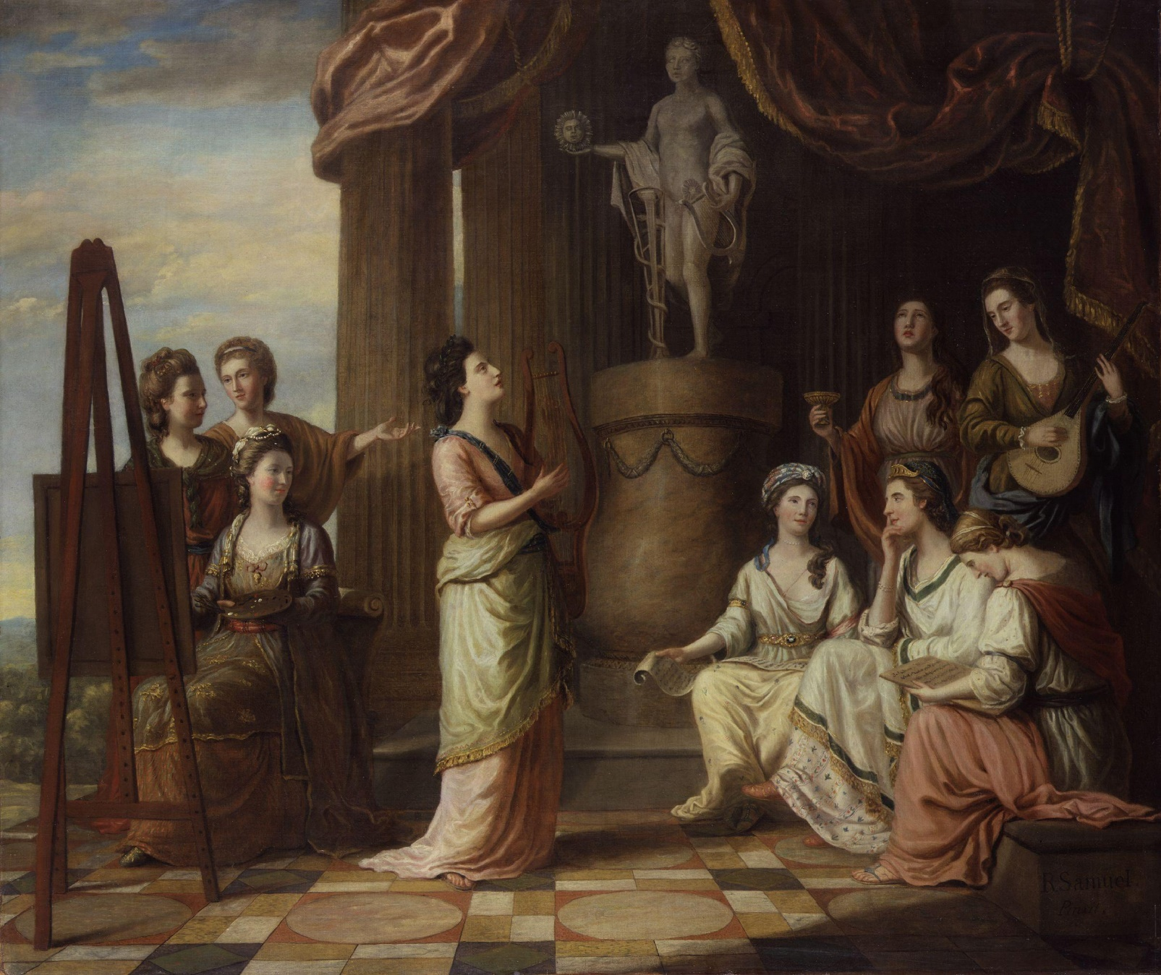
Portraits in the Characters of the Muses in the Temple of Apollo by Richard Samuel

Slide 3
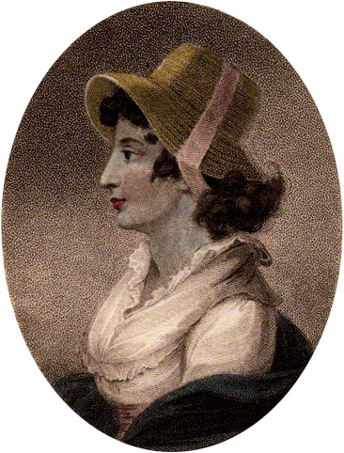
John Chapman

Slide 4
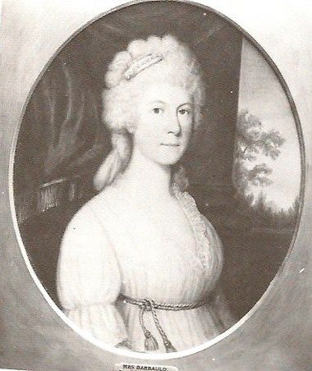
Richard Cosway

Slide 5
Anna Letitia Barbauld (1743-1825)
Praise and celebration follows her career. Her poems ՙare now in the possession of every person who has any pretensions to taste, and every library in the kingdom’ (1798, The Lady’s Monthly Museum), the young Coleridge walked 40 miles to meet her.
1774-1785: ran an experimental school with her husband, her Lessons for Children (1778-79) and Hymns in Prose for Children (1781) are among the most successful items of children’s literature of all time. Translated into many languages, including Hungarian.
Regarded by her contemporaries as one of the leading essayists and pamphleteers (on a par with Samuel Johnson)
Literary critic: first biographer of Samuel Richardson, editor of his letters, editor of The British Novelists (a 50 volume editor of 28 authors), with commentaries.

Slide 6
Rational Dissent
Née Anne Aikin, she belongs to a distinguished family of Presbiterian Dissenting intellectuals (both her father and grandfather schoolmasters)
Originating in Scottish Calvinism, Presbiterianism teaches the absolute sinfulness of human nature, i.e.: no good deed possible without direct divine intervention; we deserve nothing but the wrath of God; only God free (i.e. unmerited by acts) grace can save and only very few from damnation.
Traditions of Scottish enlightenment, especially Francis Hutcheson: placing natural goodness and love (social and divine) in the centre – associated with progressive causes, social activism
Fight for emancipation.
Commerce as a line of work and as an ideology.
‘we dissent: because we deny the right of any body of men, whether civil or ecclesiastical, to impose human tests, creeds, or articles; and because we think it our duty, not to submit to any such authority, but to protest against it, as a violation of our essential liberty to judge and act for ourselves in matters of religion’ (Andrew Kippis, 1772)

Slide 7
from Hymn III
Behold the Shepherd of the flock, he taketh care for his sheep, he leadeth them among clear brooks, he guideth them to fresh pasture; if the young lambs are weary, he carrieth them in his arms; if they wander, he bringeth them back.
But who is the shepherd's shepherd? who taketh care for him? who guideth him in the path he should go? and if he wander, who shall bring him back?
God is the shepherd's shepherd. He is the Shepherd over all; he taketh care for all; the whole earth is his fold: we are all his flock; and every herb, and every green field is the pasture which he hath prepared for us.
The mother loveth her little child; she bringeth it up on her knees; she nourisheth its body with food; she feedeth its mind with knowledge: if it is sick, she nurseth it with tender love; she watcheth over it when asleep; she forgetteth it not for a moment; she teacheth it how to be good; she rejoiceth daily in its growth.
But who is the parent of the mother? who nourisheth her with good things, and watcheth over her with tender love, and remembereth her every moment? Whose arms are about her to guard her from harm? and if she is sick, who shall heal her?
God is the parent of the mother;…

Slide 8
from Hymn V
The glorious sun is set in the west; the night-dews fall; and the air which was sultry, becomes cool.
The flowers fold up their coloured leaves; they fold themselves up, and hang their heads on the slender stalk.
The chickens are gathered under the wing of the hen, and are at rest: the hen herself is at rest also.
The little birds have ceased their warbling; they are asleep on the boughs, each one with his head behind his wing.
There is no murmur of bees around the hive, or amongst the honeyed woodbines; they have done their work, and lie close in their waxen cells. The sheep rest upon their soft fleeces, and their loud bleating is no more heard amongst the hills. There is no sound of a number of voices, or of children at play, or the trampling of busy feet, and of people hurrying to and fro. […]
Who taketh care of all people when they are sunk in sleep; when they cannot defend themselves, nor see if danger approacheth? There is an eye that never sleepeth…

Slide 9
ՙAn Address to the Deity’ (1773 [Poems]) - beginning
God of my life! and author of my days!
Permit my feeble voice to lisp thy praise;
And trembling, take upon a mortal tongue
That hallow'd name to harps of Seraphs sung.
Yet here the brightest Seraphs could no more
Than veil their faces, tremble, and adore.
Worms, angels, men, in every different sphere
Are equal all, for all are nothing here.
All nature faints beneath the mighty name,
Which nature's works, thro' all their parts proclaim.
I feel that name my inmost thoughts controul,
And breathe an awful stillness thro' my soul;
As by a charm, the waves of grief subside…

Slide 10
ՙAn Address to the Deity’ - end
I read his awful name, emblazon'd high
With golden letters on th' illumin'd sky;
Nor less the mystic characters I see
Wrought in each flower, inscrib'd in every tree;
In every leaf that trembles to the breeze
I hear the voice of GOD among the trees;
With thee in shady solitudes I walk,
With thee in busy crowded cities talk,
In every creature own thy forming power,
In each event thy providence adore.

Slide 11
ՙAn Address to the Deity’ – end (2)
Thy hopes shall animate my drooping soul,
Thy precepts guide me, and thy fear controul.
Thus shall I rest, unmov'd by all alarms,
Secure within the temple of thine arms,
From anxious cares, from gloomy terrors free,
And feel myself omnipotent in thee.

Slide 12
From ՙCorsica’ (1769)
a British muse,
Tho' weak and powerless, lifts her fervent voice,
And breathes a prayer for your success.
Oh could She scatter blessings as the morn sheds dews,
To drop upon your heads! but patient hope
Must wait the appointed hour; secure of this,
That never with the indolent and weak
Will freedom deign to dwell; she must be seiz'd
By that bold arm that wrestles for the blessing:
'Tis heaven's best prize, and must be bought with blood.

Slide 13
From ՙCorsica’ 2
When the storm thickens, when the combat burns,
And pain and death in every horrid shape
That can appall the feeble, prowl around,
Then virtue triumphs; then her tow'ring form
Dilates with kindling majesty; her mien
Breathes a diviner spirit, and enlarg'd
Each spreading feature, with an ampler port
And bolder tone, exulting, rides the storm,
And joys amidst the tempest. Then she reaps
Her golden harvest; fruits of nobler growth
And higher relish than meridian suns
Can ever ripen; fair, heroic deeds,
And godlike action…

Slide 14
From An Address to the Opposers of the Repeal of the Corporation and Test Acts (1790)
We see in you our future friends and brethren, eager to confound and blend with ours your interests and your affections. You will grant us all we ask. The only question between us is, whether you will do it to-day – To-morrow you certainly will. We appeal to the certain, sure operation of increasing light and knowledge, which it is no more in your power to stop, than to repel the tide with your naked hand, or to wither with your breath the genial influence of vegetation. The spread of that light is in general gradual and imperceptible; but there are periods when its progress is accelerated, when it seems with a sudden flash to open the firmament, and pour in day at once. Can ye not discern the signs of the times?
Reasonable, genial, progressive prophet

Slide 15
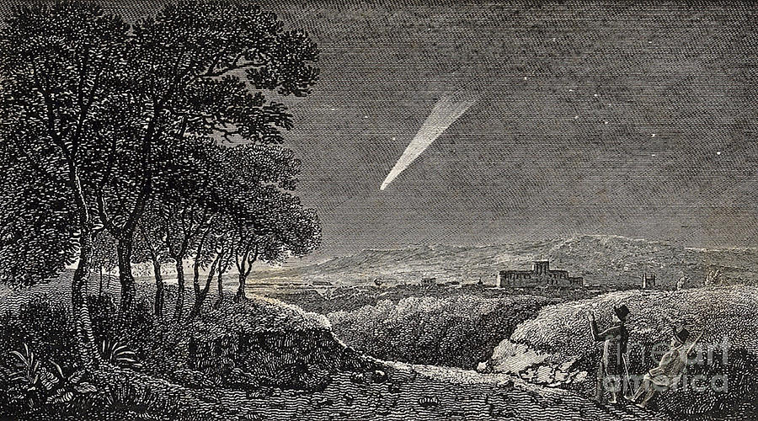
The Great Comet of 1811

Slide 16
Great Comet of 1811
Visible to the naked eye from April, 1811, to mid-January, 1812, it prompted widespread speculation that the Last Days were at hand.
Joanna Southcott: ՙthe stars in the firmament that are placed as lights for man are now wearing out.’
From an unpublished fragment by Barbauld:
Still dark with frowns return the sullen Years,
Still move with rent and blood-stain’d robes away;
The giant Force his form terrific rears
To heaven, and bids th’ astonished world obey.
ՙgiant force’ could be the comet, Napoleon, or the Antichrist (Armageddon at hand)

Slide 17
Apocalyptic politics and economy
England had been at war with France for seventeen years, and a favourable outcome for England appeared doubtful.
Russia, Spain, and Austria had already surrendered to Napoleon and his army.
A series of bankruptcies in 1810 resulted in a marked slowdown of production, labour cutbacks, and riots. The wartime strategy of blockading ports brought trading to an almost complete standstill.
BUT the struggle helps articulate major intellectual and political forces – internationalism, pacifism, admiration of American democracy, and the belief that free commercial intercourse between nations would end wars which could serve only the interests of aristocrats, militarists and political reactionaries.
increased hostilities with the United States,
George III’s inability to rule the nation and the appointment of his profligate and unpopular son to Regent. Mental illness was still a divine judgment meted out to sinners, or the British nation as a whole.
famine and disease that spread throughout the country despite the bountiful crops of 1811, and the mounting death toll of the British soldiers

Slide 18
Prophecy as a shared language
After 1789, England witnessed a resurgence of millenarianism unlike anything since the proliferation of published prophecies during the Civil War. Prophecies were published as street literature in broadsheets, chapbooks, and almanacs, but also in weighty treatises: the Dissenting publisher Joseph Johnson published over thirty books of contemporary eschatology. Cashing in on the market, collections of prophecies from the sixteenth and seventeenth centuries were excerpted and republished anonymously. So many prophecies were published that the Monthly Review created a separate heading, ‘Modern Prophecy’, in order to review them.
One surviving document from the Luddite rebellion is dated February 1812, the same month that Eighteen Hundred and Eleven was published.
Sir, We begin with the Language of the Prophets of old, in saying, that your Destruction is at Hand, and why? Because we the Cotton Spinners of this Town, have been the means of raising you from the Dunghill, to Independency; & now you with others, have employed so many of the Female Sex, that we, and our little ones, are starving for want of Bread; and if you are determined to persevere, you may expect something destructive immediately – So we conclude with a Reform or Death

Slide 19
Cultural War in Britain (speaking under duress)
The small community of radical, oppositional thinkers and writers had been effectively suppressed by the events of the 1790s. Condemned as Jacobins, atheists, and traitors, few members of a once-thriving community of radical thinkers survived the decades after the French Revolution with both their careers and their ideals intact. Radicals responded in different ways to the dangerously reactionary atmosphere of wartime Britain. Some apostatized their former opinions (Southey, Coleridge), suppressed their more daring work (Wordsworth), or published pseudonymously and obscurely (William Godwin). Those who insisted on speaking out found themselves imprisoned like John Thelwall, transported to the new antipodean penal colony at Sydney Cove like the so-called Scottish Martyrs (among whom was Barbauld’s friend Thomas Muir) or, as in the case of Barbauld’s friend Joseph Priestley, hounded into exile by a violent, bigoted public. Barbauld, of course, was not untouched by these events, but for a long time she escaped direct, personal attacks. She appears to have been, in part at least, protected by virtue of her gender: a respectable, married woman whose acclaimed poetry and writing for children displayed strong religious themes, she was not an obvious target for violent mobs or legal prosecution. Her practice of only sporadic publication may also have offered some defence against persecution.

Slide 20
Opening: Britain under apocalyptic siege
Still the loud death drum, thundering from afar,
O'er the vext nations pours the storm of war:
To the stern call still Britain bends her ear,
Feeds the fierce strife, the alternate hope and fear;
Bravely, though vainly, dares to strive with Fate,
And seeks by turns to prop each sinking state.
Colossal Power with overwhelming force
Bears down each fort of Freedom in its course;
Prostrate she lies beneath the Despot s sway,
While the hushed nations curse him—and obey.

Slide 21
Opening (notes)
A sense of chaos, loss of direction and agency, helplessness.
You don’t know who is playing the drums: is it us or them? Storm seems to be the dominant metaphor, recognising no distinction between friend and enemy. Maybe because war itself is the enemy?
No clear stance or ideology yet.

Slide 22
Section 2: anti-war statement
Bounteous in vain, with frantic man at strife,
Glad Nature pours the means–the joys of life;
In vain with orange blossoms scents the gale,
The hills with olives clothes, with corn the vale;
Man calls to Famine, nor invokes in vain, {15}
Disease and Rapine follow in her train;
The tramp of marching hosts disturbs the plough,
The sword, not sickle, reaps the harvest now,
And where the Soldier gleans the scant supply,
The helpless Peasant but retires to die; {20}
No laws his hut from licensed outrage shield,
And war's least horror is the ensanguined field.

Slide 23
Section 2
Fruitful in vain, the matron counts with pride
The blooming youths that grace her honoured side;
No son returns to press her widow'd hand, {25}
Her fallen blossoms strew a foreign strand.
–Fruitful in vain, she boasts her virgin race,
Whom cultured arts adorn and gentlest grace;
Defrauded of its homage, Beauty mourns,
And the rose withers on its virgin thorns. {30}
Frequent, some stream obscure, some uncouth name
By deeds of blood is lifted into fame;
Oft o'er the daily page some soft-one bends
To learn the fate of husband, brothers, friends,
Or the spread map with anxious eye explores, {35}
Its dotted boundaries and penciled shores,
Asks where the spot that wrecked her bliss is found,
And learns its name but to detest the sound.

Slide 24
Notes
subvert the tropes of heroic, war-affirming poetry, next presenting the chronicling of war, the “daily page” of army and navy bulletins (33), or the “spread map” of battle locations (35) as significant not for their value as historical records of territory won and lost, but merely as sites of unnecessary death, adjuncts to mourning
Thomas Malthus in his 1798 Essay on the Principle of Population. Malthusian doctrine claims that war, famine, and disease work to keep human populations from outstripping their (presumptively finite) food supply. Barbauld here inverts Malthus’s neat formula by emphasizing humanity’s self-defeating conflict with a Nature that, without war, abundantly offers “the joys of life”
While the identification of women with nature is an ancient archetype often used to subjugate women, here Barbauld overturns this kind of literary commonplace in order to reposition the needs and productions of women, as well as of nature, at the forefront of a nation’s rightful concerns. …the impact is figured in terms of a wasted natural bounty: the soldiers are lost as a sterile, unproductive, “virgin race” (27) and this sterility infects the women of England

Slide 25
Ruin, as with an earthquake shock, is here,
Yes, thou must droop; thy Midas dream is o'er;
The golden tide of Commerce leaves thy shore,
Leaves thee to prove the alternate ills that haunt
Enfeebling Luxury and ghastly Want;
Leaves thee, perhaps, to visit distant lands, {65}
And deal the gifts of Heaven with equal hands.

Slide 26
From ‘Against Inconsistency in Our Expectations’ (1769)
If you refuse to pay the price, why expect the purchase? We should consider
this world as a great mart of commerce, where Fortune exposes to our view
various commodities, riches, ease, tranquillity, fame integrity, knowledge.
Every thing is marked at a settled price. Our time, our labour, our ingenuity, is so much ready money which we are to lay out to the best advantage.
Examine, compare, chuse, reject; but stand to your own judgment; and do
not, like children, when you have purchased one thing, repine that you do
not possess another which you did not purchase.

Slide 27
Elegiac Patriotism
Yet, O my Country, name beloved, revered,
By every tie that binds the soul endeared,
Whose image to my infant senses came
Mixt with Religion's light and Freedom's holy flame! {70}
If prayers may not avert, if 'tis thy fate
To rank amongst the names that once were great,
Not like the dim cold Crescent shalt thou fade,
Thy debt to Science and the Muse unpaid;
Thine are the laws surrounding states revere, {75}
Thine the full harvest of the mental year,
Thine the bright stars in Glory's sky that shine,
And arts that make it life to live are thine.
If westward streams the light that leaves thy shores,
Still from thy lamp the streaming radiance pours. {80}

Slide 28
Elegiac Patriotism 2
Wide spreads thy race from Ganges to the pole,
O'er half the western world thy accents roll:
Nations beyond the Apalachian hills
Thy hand has planted and thy spirit fills:
Soon as their gradual progress shall impart {85}
The finer sense of morals and of art,
Thy stores of knowledge the new states shall know,
And think thy thoughts, and with thy fancy glow;
Thy Lockes, thy Paleys shall instruct their youth,
Thy leading star direct their search for truth; {90}
Beneath the spreading Platan's tent-like shade,
Or by Missouri's rushing waters laid,
"Old father Thames" shall be the Poets' theme,
Of Hagley's woods the enamoured virgin dream,
And Milton's tones the raptured ear enthrall, {95}
Mixt with the roar of Niagara's fall; …

Slide 29
Prophecy as Remembrance
Yet then the ingenuous youth whom Fancy fires
With pictured glories of illustrious sires,
With duteous zeal their pilgrimage shall take
From the blue mountains, or Ontario's lake, {130}
With fond adoring steps to press the sod
By statesmen, sages, poets, heroes trod;
On Isis' banks to draw inspiring air,
From Runnymede to send the patriot's prayer;
In pensive thought, where Cam's slow waters wind, {135}
To meet those shades that ruled the realms of mind;
In silent halls to sculptured marbles bow,
And hang fresh wreaths round Newton's awful brow.
Oft shall they seek some peasant's homely shed,
Who toils, unconscious of the mighty dead, {140}
To ask where Avon's winding waters stray, ….

Slide 30
Cosmopolitan, multicultural London
But who their mingled feelings shall pursue
When London's faded glories rise to view?
The mighty city, which by every road,
In floods of people poured itself abroad; {160}
Ungirt by walls, irregularly great,
No jealous drawbridge, and no closing gate;
Whose merchants (such the state which commerce brings)
Sent forth their mandates to dependant kings;
Streets, where the turban'd Moslem, bearded Jew, {165}
And woolly Afric, met the brown Hindu;
Where through each vein spontaneous plenty flowed,
Where Wealth enjoyed, and Charity bestowed.
Pensive and thoughtful shall the wanderers greet
Each splendid square, and still, untrodden street; {170}
Or of some crumbling turret, mined by time,
The broken stair with perilous step shall climb,
Thence stretch their view the wide horizon round,
By scattered hamlets trace its antient bound,
And, choked no more with fleets, fair Thames survey {175}
Through reeds and sedge pursue his idle way.

Slide 31
The prophecy 1
There walks a Spirit o'er the peopled earth, {215}
Secret his progress is, unknown his birth;
Moody and viewless as the changing wind,
No force arrests his foot, no chains can bind;
Where'er he turns, the human brute awakes,
And, roused to better life, his sordid hut forsakes: {220}
He thinks, he reasons, glows with purer fires,
Feels finer wants, and burns with new desires:
Obedient Nature follows where he leads;
The steaming marsh is changed to fruitful meads;
The beasts retire from man's asserted reign, {225}
And prove his kingdom was not given in vain.

Slide 32
The Prophecy 2
And now the vagrant Power no more detains
The vale of Tempe, or Ausonian [Italian] plains; {260}
Northward he throws the animating ray,
O'er Celtic nations bursts the mental day:
And, as some playful child the mirror turns,
Now here now there the moving lustre burns; […]
…to other climes the Genius soars,
He turns from Europe's desolated shores;
And lo, even now, midst mountains wrapt in storm,
On Andes' heights he shrouds his awful form;
On Chimborazo's summits treads sublime, {325}
Measuring in lofty thought the march of Time;
Sudden he calls:– " 'Tis now the hour!" he cries,
Spreads his broad hand, and bids the nations rise.
La Plata hears amidst her torrents' roar;
Potosi hears it, as she digs the ore: {330}
Ardent, the Genius fans the noble strife,
And pours through feeble souls a higher life,
Shouts to the mingled tribes from sea to sea,
And swears–Thy world, Columbus, shall be free.

Slide 33
Recommended Literature
McCarthy, William and Elizabeth Cratf, eds. Anna Letitia Barbauld: Selected Poetry and Prose. Toronto: Broadview, 2002.
Watkins, Daniel P. Anna Letitia Barbauld and Eighteenth- Century Visionary Poetics. Baltimore: The Johns Hopkins University Press, 2012.
Smith, Orianne. Anna Barbauld as Enlightenment Prophet. In Romantic Women Writers, Revolution, and Prophecy. Rebellious Daughters, 1786–1826. Cambridge: CUP, 2013. 158-189.
Clery, E. J. Eighteen hundred and eleven : poetry, protest and economic crisis. Cambridge: CUP, 2017.
Murphy, Olivia. Anna Letitia Barbauld, Eighteen Hundred and Eleven (1812). In Handbook of British Romanticism, ed. Ralf Haekel. Berlin, Boston: De Gruyter, 2017.
Miles, Robert. Romantic misfits. Basingstoke: Palgrave, 2008. 170-206.
McCarthy, William. How Dissent made Anna Letitia Barbauld, and what she made of Dissent. In Religious dissent and the Aikin-Barbauld circle, 1740-1860, eds. Felicity James and Ian Inkster. Cambridge: CUP, 2012.
McCarthy, William. Anna Letitia Barbauld: Voice of the Enlightenment. Baltimore: The Johns Hopkins UP, 2008.

