Slide 1
Charlotte Smith, Elegiac Sonnets (1784)

Slide 2
Sonnet Revival
Assumptions about the demise of the sonnet after Milton are based mainly on the fact that major authors such as Pope, Dryden and Johnson used the sonnet only sparingly, Pope published sonnets ‘in imitation of Waller’, aged thirteen.
Dryden : ‘The French have set up purity for the standard of their language; and a masculine vigour is that of ours. Like their tongue is the genius of their poets, light and trifling in comparison of the English – more proper for sonnets, madrigals, and elegies than heroic poetry.’
Johnson: of Milton’s sonnets: ‘of the best it can only be said, that they are not bad’, ‘The fabrick of a sonnet, however adapted to the Italian language, has never succeeded in ours…Those little pieces may be dispatched without much anxiety …’ in Dictionary (1755): ‘It is not very suitable to the English language, and has not been used by any man of eminence since Milton.’

Slide 3
Lonely Feeling
Coleridge on Charlotte Smith and William Bowles: the poets ‘who first made the Sonnet popular among the present English’ … ‘In a Sonnet … we require a development of some lonely feeling, by whatever cause it may have been excited, but those Sonnets appear to me the most exquisite, in which moral Sentiments, Affections, or Feelings, are deduced from, and associated with, the scenery of Nature. Such compositions generate a habit of thought highly favourable to delicacy of character. They create a sweet and indissoluble union between the intellectual and material world’ (‘Preface’ to Sonnets from Various Authors (1796))
Smith: each poem is ‘no improper vehicle for a single sentiment’ (Preface to Elegiac Sonnets)
Extremely personal and extremely conventional, moment of spontaneity and consciousness of form and tradition

Slide 4
Self-Pity
Charlotte Smith made a virtual career out of self­-pity. She rises from it in her novels, but it is the obsession of her poetry and, to judge by her letters, of her life. But, in sober fact, she had ample justification. In 1783 she joined her wastrel husband, to whom she had been forcibly married in mid­-adolescence, in debtors' prison, surrounded with a veritable brood of their children. In effect, from that point on they were her sole responsibility, and her recourse was to write—and write. The first edition of her Elegiac Sonnets in 1784 brought her sudden fame and opportunity, but for her the profession of letters was not an indulgence in feminine liberation nor in middle­class mobility; it was an absolute necessity. By 1787 she had separated from Benjamin Smith with responsibility for nine children but no legal freedom. Instead, her husband could comfortably pursue his ways with the insurance of a new and more secure source of income to relieve his chronically dire straits, that guaranteed by his wife's publishing contracts. There was no escaping him, nor was there any legal means, though Smith pursued them all, of independently attaching money left from his father to set up trusts for her children. So it went until her last year, when during her own decline, in a cruel irony, she received news of her husband's death. (Stuart Curran, ‘Romantic Poetry: The I Altered’, 1988)

Slide 5
Smith on her Marriage
'sold, a legal prostitute' to Benjamin Smith (at 15)
'once in his coach going to dine at Lord Clanricarde's he threw a large bunch of keys at me and hurt me on the breast, without any provocation … I could have brought another person… who would have taken the most solemn oath that she has seen him strike and kick me, and once at table, throw a quatern loaf at my head without provocation at all but the phrenzy, for so it seemed at the moment’.
Plantations, slave trade, gambling, infidelities…
Wives were not necessarily expected to accompany their husbands, but prisoners had little food fit to eat unless a relative brought it in daily… With nine children at Bignor, she had every excuse for absenting herself throughout his imprisonment. But she stayed with him often during the early months of 1784, and in May fell pregnant again in these grim surroundings.
BUT: in that summer of 1784, the profits [from Elegiac Sonnets] allow her to pay the rent and feed her children
Elegiac Sonnets and Other Essays. By Charlotte Smith, of Bignor Park, Sussex
Informal separation, otherwise Benjamin had had custody

Slide 6
Reception
Coleridge acknowledged Smith along with William Bowles (whose sonnets were largely imitations of the kind Smith had invented) as a preeminent reviver of the sonnet
Wordsworth called her "a lady to whom English verse is under greater obligations than are likely to be acknowledged, or remembered."
Early reviews: extravagant praise + eighteenth-century view that the sonnet form had proven itself fundamentally incompatible with English poetry: "A very trifling compliment is paid Mrs. Smith, when it is observed how much her Sonnets exceed those of Shakespeare and Milton. She had undoubtedly conferred honour on a species of poetry which most other predecessors in this country have disgraced.”
“Every province has its separate competitors. Over the epic field, Milton, of all British bards, triumphs without a rival, Shakespeare in the dramatic, and in the sonnet, Charlotte Smith.”

Slide 7
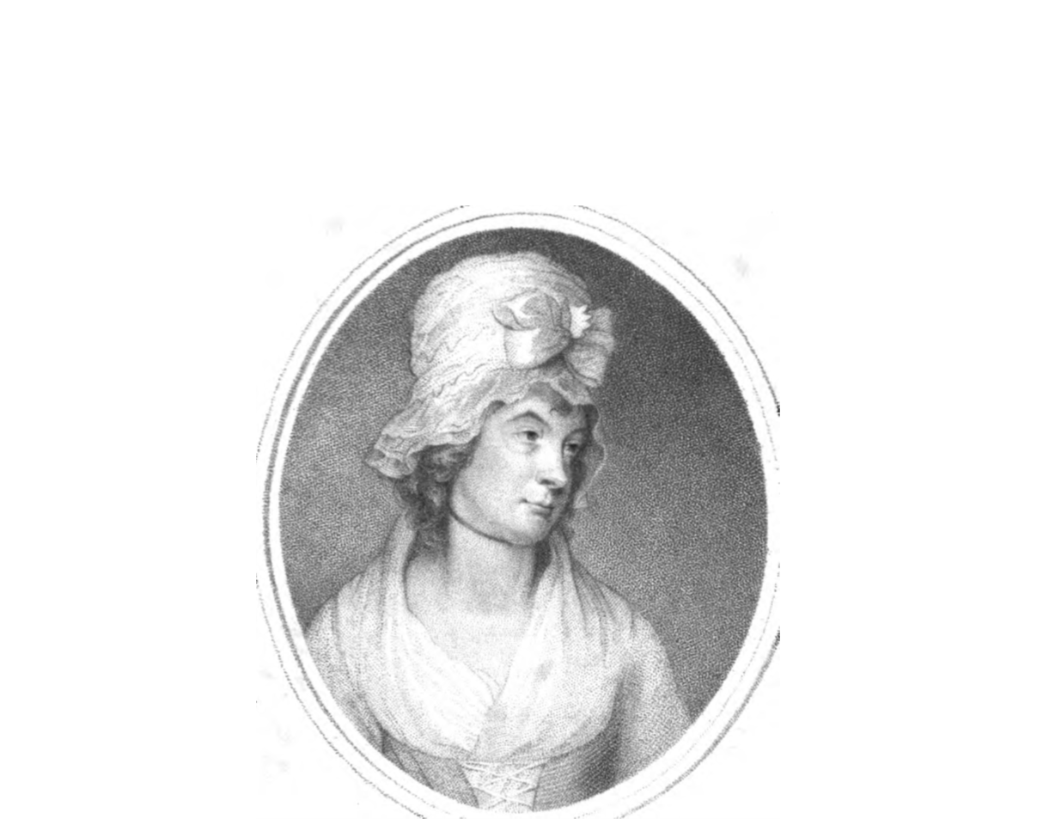
Frontispiece
Oh! Time has Changed me since you saw me last,
And heavy Hours with Time’s deforming Hand,
Have written strange Defeatures in my face.

Slide 8
Frontispiece (notes)
All middle-class propriety.
Reader is an old acquaintance, but we haven’t seen each other for quite a while (close and distant).
You recognise me, but only to notice that I am no longer the same.
The speaker is a familiar face, but its features are ”defeatures” (not quite a human face, more a record of the ravages of time)
Offering herself to be observed and examined, conscious of being looked at (the solitary sonneteer is also a performer in front of an audience).

Slide 9
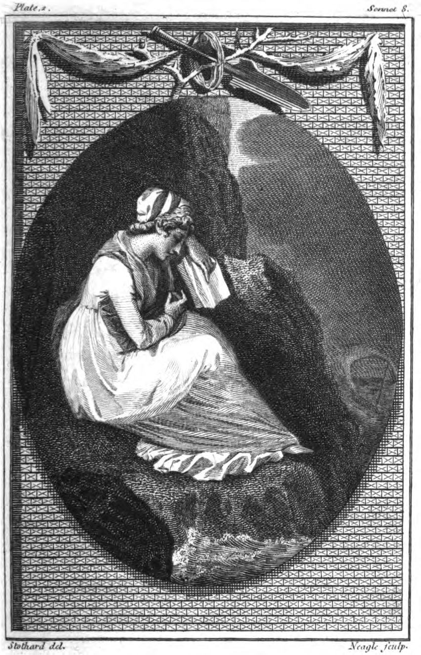
Plates
On some rude fragment of the rocky shore.

Slide 10
From ‘Preface’ to the 6th edition (1792)
…notwithstanding I am thus frequently appearing as an authoress, and have derived from thence many of the greatest advantages of my life, (since it has procured me friends whose attachment is most invaluable) I am well aware that for a woman—‘The post of honor is a private station.’ [Addison’s Cato]

Slide 11
SONNET I.
THE partial Muse has, from my earliest hours,
Smil'd on the rugged path I'm doom'd to tread,
And still with sportive hand has snatch'd wild flow'rs,
To weave fantastic garlands for my head:
But far, far happier is the lot of those
Who never learn'd her dear delusive art;
Which, while it decks the head with many a rose,
Reserves the thorn, to fester in the heart.
For still she bids soft Pity's melting eye
Stream o'er the ills she knows not to remove,
Points ev'ry pang, and deepens ev'ry sigh
Of mourning Friendship, or unhappy Love.
Ah! then, how dear the Muse's favors cost,
If those paint sorrow best—who feel it most.

Slide 12
Sonnet I. (notes)
Quatrains 1-2: is pain the source or the consequence of poetry? Does poetry alleviate or perpetuate the suffering? What is the muse smiling at?
Does poetry come from the heart (expression) or does it do something to the heart (‘fester in the heart’)?
Paradox of weaving garlands: both natural and artificial (like the genre, like the emotion described).
Pope's Eloisa to Abelard. ‘The well-sung woes shall soothe my pensive ghost; / He best can paint them who shall feel them most’. Smith's sonnet leads precisely to a reversal of that claim about sympathy, affect and writing.
Personal pain is articulated through repetition, a quote.
This poem stems from a long tradition- the heroic epistle in which male poets give voice to female suffering. [Robinson]
Problematization of pity, the ‘woman in need’ trope on which the project was supposed to be built. Speaker’s gender never mentioned.
‘the ills she knows not to remove’ (suffering, like the pangs of love in renaissance cycles needs to be prolonged)
A triumphantly perfect Shakespearean sonnet (not typical or ‘legitimate’)

Slide 13
SONNET IV. To the Moon.
QUEEN of the silver bow!—by thy pale beam,
Alone and pensive, I delight to stray,
And watch thy shadow trembling in the stream,
Or mark the floating clouds that cross thy way.
And while I gaze, thy mild and placid light
Sheds a soft calm upon my troubled breast;
And oft I think—fair planet of the night—
That in thy orb, the wretched may have rest:
The suff'rers of the earth perhaps may go,
Releas'd by Death—to thy benignant sphere,
And the sad children of Despair and Woe
Forget, in thee, their cup of sorrow here.
Oh! that I soon may reach thy world serene,
Poor wearied pilgrim—in this toiling scene!

Slide 14
SONNET IV. To the Moon. (Plate)

Slide 15
SONNET IV. To the Moon. (Notes)
A non-Christian heaven
Moon goddess instead of God the Father (conventional vocabulary of femininity – soft, placid, etc. – married to the spiritual challenge)
Called a scene, suggesting art, convention, many first-person pronouns, but a generic sentiment
Plate depicting a generic stand-in beauty

Slide 16
SONNET XLIV. Written in the Church Yard at Middleton in Sussex.
PRESS'D by the Moon, mute arbitress of tides,
While the loud equinox its pow'r combines,
The sea no more its swelling surge confines,
But o'er the shrinking land sublimely rides.
The wild blasts, rising from the western cave,
Drives the huge billows from their heaving bed;
Tears from their grassy tombs the village dead,
And breaks the silent sabbath of the grave!
With shells and seaweed mingled, on the shore,
Lo! their bones whiten in the frequent wave;
But vain to them the winds and waters rave;
They hear the warring elements no more:
While I am doom'd—by life's long storm opprest,
To gaze with envy, on their gloomy rest.

Slide 17
SONNET XLIV. Written in the Church Yard at Middleton in Sussex.
From ‘Pressed’ to ‘opprest’ [playthings of circumstance]
Speaker as both observer and observed (in a natural environment), observer and participant, even competitor (for the reader’s pity)
Combination of Shakespearean (couplet) and Petrarchan (embracing rhymes, strong volta after line eight) patterns
Petrarchan: octave about first Moon then wind affecting the waters, sestet about the bones and the speaker
Shakespearean: 3 quatrains about Moon, wind, bones; couplet about contrast
Poem of melancholy, but also conscious artifice which creates aesthetic distance: “oo” sound in the final lines (“doom’d,” “gloomy”), which circle back to the sound introduced in the first line (“Moon,” “mute”); multiple connotations: (“shrinking”) before a physical threat; “sublimely”, “silent sabbath,” and bones whitening

Slide 18
SONNET XIII. From Petrarch.
OH! place me where the burning noon
Forbids the wither'd flow'r to blow;
Or place me in the frigid zone,
On mountains of eternal snow:
Let me pursue the steps of Fame,
Or Poverty's more tranquil road;
Let youth's warm tide my veins inflame,
Or sixty winters chill my blood:
Tho' my fond soul to Heav'n were flown,
Or tho' on Earth 'tis doom'd to pine,
Prisoner or free—obscure or known,
My heart, oh Laura! still is thine.
Whate'er my destiny may be,
That faithful heart, still burns for thee!

Slide 19
SONNET XIII. From Petrarch. Notes
Free translations
Burn…burn (external to internal fire)
The distressed female seamlessly becomes the ardent male lover (types of pain merge gracefully)
Petrarchan, but with Shakespearean rhyme scheme and in iambic tetrameter
Both perfect and imperfect, both same and different
Violent extremes and permanence (Petrarchan)
Difference highlights imitation, artificiality, like an actor putting on a role

Slide 20
XCI: Reflections on Some Drawings of Plants
I can in groups these mimic flowers compose,
These bells and golden eyes, embathed in dew;
Catch the soft blush that warms the early Rose,
Or the pale Iris cloud with veins of blue;
Copy the scallop'd leaves, and downy stems,
And bid the pencil's varied shades arrest
Spring's humid buds, and Summer's musky gems:
But, save the portrait on my bleeding breast,
I have no semblance of that form adored,
That form, expressive of a soul divine,
So early blighted; and while life is mine,
With fond regret, and ceaseless grief deplored —
That grief, my angel! with too faithful art
Enshrines thy image in thy Mother's heart.

Slide 21
XCI: Reflections on Some Drawings of Plants (notes)
Anna Augusta was an adult when she died of childbirth in 1795 (more about roles than recording experience)
Fixed in the role of grieving motherhood
Enabled by the same role as an artist, her pain leads to more faithful art
Almost sacred iconography of mother’s breast, heart, tears – mater dolorosa tradition
Orderly composition based on precise observation as opposed to a poetics of boundless pathos, leading to a more precise picture, nevertheless

Slide 22
Recommended Literature
Andrews, Kerri. ‘”Herself [...] Fills The Foreground”: Negotiating Autobiography in the Elegiac Sonnets and The Emigrants’. Charlotte Smith in British Romanticism, ed. Jacqueline Labbe. London: Pickering & Chatto, 2008.
Backscheider, Paula R. Eighteenth-Century Women Poets and Their Poetry: Inventing Agency, Inventing Genre. Baltimore: The Johns Hopkins UP, 2005. 316-375.
Behrendt, Stephen C. British Women Poets and the Romantic Writing Community. Baltimore: The Johns Hopkins UP, 2009. 115-151.
Curran, Stuart. Poetic Form and British Romanticism. Oxford: Oxford UP, 1986. 29-55.
Curran, Stuart. 'Romantic poetry: The I altered’. Romanticism and Feminism, ed A.K. Mellor. Bloomington: Indiana UP, 1988. 185-203.
Fletcher, Loraine. Charlotte Smith: A Critical Biography. Basingstoke: Palgrave Macmillan, 1998.
Labbe, Jacqueline M. Charlotte Smith: Romanticism, poetry and the culture of gender. Manchester and New York: Manchester UP, 2003. [chapters 1-3]
O’Neill, Michael. 'The Romantic sonnet'. The Cambridge Companion to the Sonnet, eds. A. D. Cousins and Peter Howarth. Cambridge: Cambridge UP, 2011. 185-203.
Raymond, Mark. 'The Romantic Sonnet Revival: Opening the Sonnet’s Crypt’. Literature Compass 4/3 (2007): 721–736.

