Slide 1
Syntax
Lecture 1
Krisztina Szécsényi

Slide 2
A short revision: linguistics
Linguistics as an interdisciplinary field
(chart on next slide taken from the linguistics programme of Middlebury)

Slide 3
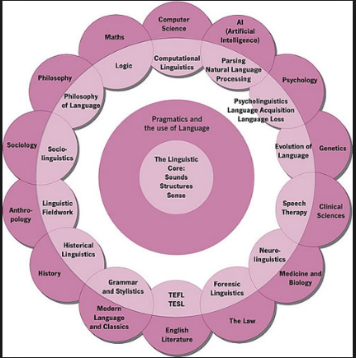

Slide 4
Core linguistics
Linguistics:
Language = ?
Knowledge of language
Acquisition of language

Slide 5


Slide 6
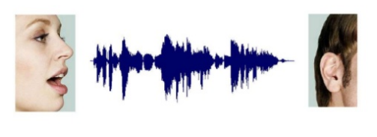

Slide 7
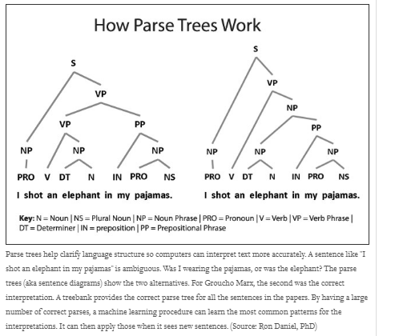

Slide 8
Syntax
The study of sentence and phrase structure
Generative grammar: rules that generate all and only the well-formed expressions of language
Simplicity: to account for the relative ease of acquisition
The structure building component: X-bar Theory
Rewrite rules, syntactic trees/phrase markers

