Slide 1
The History of Phrase Structure
Linguistic Theories
Mark Newson

Slide 2
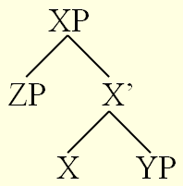
Current Ideas on Phrase Structure
All Phrases look like this:
Every phrase contains a word which determines the category of the phrase (= Head);
Every phrase has a potential position for another phrase directly associated with the head (= Complement);
Every phrase has a second potential position for another phrase more indirectly connected to the head (= Specifier).
This is called Generalised X-bar theory.

Slide 3
Heads
All words are heads.
Every phrase has a head.
words and phrases are in a one to one correspondence.
Words have categories (nouns, adjectives, prepositions, etc.).
The category of the head is the category of the phrase (a noun projects an NP, an adjective an AP, etc.).

Slide 4
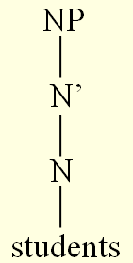
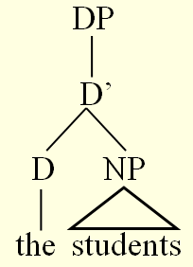
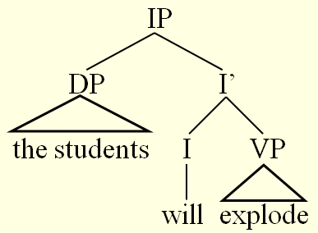
Examples of heads a phrases

Slide 5
Where did this view come from?
We can trace the current view to the middle of the 1980s.
X-bar theory was generalised to apply to all words.
Previously X-bar theory only applied to N, V, A and P.
Words like determiners and inflections were not seen as heads.
Sentences were not seen as phrases.

Slide 6
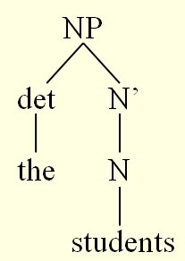
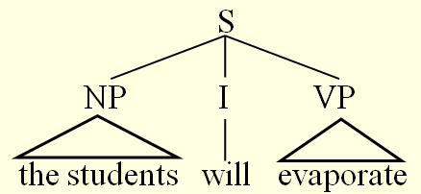
Examples of pre-1980s phrases

Slide 7
Where did this view come from?
X-bar theory was invented by Chomsky (1970)
(his first version only concerned N, V and A)
It was proposed to account for similarities between different phrases:
[_{NP} observation of the rules]
[_{VP} observe the rules]
[_{AP} observant of the rules]
In all of these phrases, the head (V in VP, N in NP, A in AP) is followed by its complement phrase

Slide 8
Where did this view come from?
It also imposed restrictions on phrases:
Previously there was no reason why a noun phrase should contain a noun, for example.
Some phrases had heads (endocentric).
Some didn’t (exocentric).
So there was no clear notion of what a head is.

Slide 9
Pre-1970 phrase structure rules
Grammars were seen as a set of language and construction specific rules.
Some of these rules concerned phrase structure (Phrase Structure Rules).
NP → det N
VP → V NP
S → NP VP
These rules tell us how to construct phrases:
Draw the symbol on the left at the top
Draw branches down from this to each of the symbols of the right
Put words into the lowest nodes
NP
det
N
the
students

Slide 10
Where did these ideas come from?
Chomsky 1956 Syntactic Structures
Invented Phrase Structure Rules and tree diagrams.
Formal representation of ideas he was arguing against.
These ideas had not been formalised and so were not particularly precise:
and therefore couldn’t easily be argued against.

Slide 11
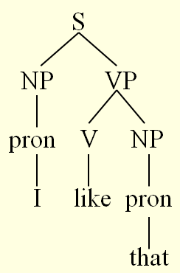
Chomsky’s argument: there is more than phrase structure
Discontinuous constituents:
That, I like!
S → NP VP
VP → V NP
NP → Pron
These rule produce this structure.

Slide 12
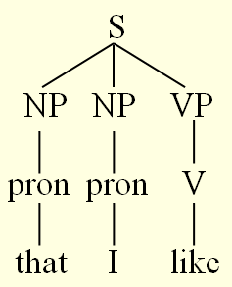
Chomsky’s argument: there is more than phrase structure
Discontinuous constituents:
That, I like!
S → NP VP
VP → V NP
NP → Pron
These rule produce this structure.
Other rules could produce this structure –
But where is the object?

Slide 13
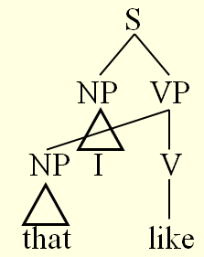
Chomsky’s argument: there is more than phrase structure
Discontinuous constituents:
That, I like!
S → NP VP
VP → V NP
NP → Pron
These rule produce this structure.
Other rules could produce this structure –
But where is the object?
Phrase Structure Rules cannot produce trees with crossing branches.

Slide 14
A slight deception
Chomsky argues against Phrase Structure Rules,
Which he made up!
As a representation of what went before.

Slide 15
So what went before?
Later American Structuralism:
(Hockett, Harris – Chomsky’s teacher)
Hockett developed Immediate Constituent Analysis:
The idea that larger units in a sentence are broken down into successively smaller units.
Hockett did not develop rules for this idea (no formalism).
He did invent a representation: Chinese Boxes

Slide 16
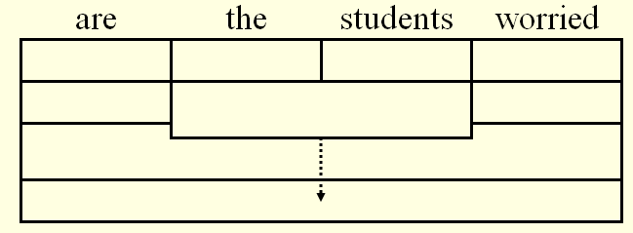
Chinese Boxes
Discontinuous constituents

Slide 17
Chomsky’s point
Because there are no rules, you can do anything with Immediate Constituent Analysis.
American Structuralism was not much concerned with explanation.
It wanted to describe linguistic phenomena:
How we described it was unimportant

Slide 18
Where did Immediate Constituent Analysis come from?
Bloomfield (founder of American Structuralism):
1933 Language
Contained a chapter on syntax describing phrases.
This was a rewrite of a book An Introduction to the Study of Language (1914)
Contained the word ‘phrase’ twice – both referring to the notion of an idiom.
Conclusion:
Bloomfield invented the notion of a ‘phrase’ sometime in the 1920s

Slide 19
Bloomfield’s notion of a phrase
His discussion of phrases in Language is not particularly detailed.
Phrases based on distributional evidence:
I’m sorry for poor John
Poor John has to leave
Unlucky though poor John is, I admire him
‘Head’ also defined in terms of distribution
The head of a phrase is that word in it which has the same distribution as the phrase.
So ‘John’ is the head of ‘poor John’
But ‘to’ is not the head of ‘to London’

Slide 20
Where did Bloomfield’s notion of a phrase come from?
Bloomfield was trained as a linguist in America.
Boas was the main influence at the time

Slide 21
Franz Boas
German philologist and anthropologist.
Worked in America on Amerindian languages and culture.
Proponent of Linguistic Relativity:
Language systems can only be understood in terms of their own principles – can’t generalise from one language to another.
Urgent need to collect data →
Development of field methods = discovery procedures:
A set of tests for discovering linguistic units (phonemes, morphemes, etc. – not phrases) mainly based on the notion of distribution.

Slide 22
Where did Bloomfield’s notion of a phrase come from?
Bloomfield was trained as a linguist in America.
Boas was the main influence at the time
Bloomfield studied in Europe (1913-14)
Impressed by Wundt

Slide 23
Wilhelm Wundt
German psychologist
Father of experimental psychology.
Wanted to make psychology scientific (experiment based)
Thought subjects could be trained to self reflect on mental processes
Became discredited in America during the rise of Behaviourism.

Slide 24
Where did Bloomfield’s notion of a phrase come from?
Bloomfield was trained as a linguist in America.
Boas was the main influence at the time
Bloomfield studied in Europe (1913-14)
Impressed by Wilhelm Wundt
Bloomfield wanted to make linguistics scientific.
Switched to Behaviourism after fall of Wundt

Slide 25
Behaviourism
Extreme version of empiricism (operationalism):
Only allows ideas based on direct observation.
Therefore the mind does not exist.
There are stimuli (the observable environment) and responses (visible behaviour).

Slide 26
Bloomfield’s linguistic behaviourism
Only things which are linked to directly observable phenomena can be entertained.
Phones are directly observable.
‘Linking’ comes through discovery procedures (mainly distributional tests)
We can discover phonemes by directly examining the distributional behaviour of phones
We can discover morphemes by examining the distributional behaviour of phonemes
Etc.
All this sets up the conditions for the discovery of the phrase:
Phrases can be observed by examining the distributional behaviour of groups of words.

Slide 27
Why the phrase wasn’t discovered earlier
Language has been studied for more than 2500 years.
Indian linguistics (before the middle of 1st millennium BCE)
Greek linguistics
Latin linguistics
European linguistics
Middle Ages
Comparative Lingustics
Structuralism

Slide 28
Indian schools of linguistics
Most well known work is Pãnini’s grammar (written sometime between 500 and 300 BCE).
Was concerned with preserving the Vedic scripts (Sanskrit), used only in religious context.
Very limited aims, no comparison with other languages
Sanskrit was a highly inflecting, fairly free word order language
So concentration was on studying phonology, morphology and meaning, rather than syntax.
Highly unlikely to have developed a notion of phrase.

Slide 29
Greek Linguistics
Classical scholars (Socrates, Plato and Aristotle) – middle of 1st millennium BCE
Mainly interested in philosophy
Interest in language extended only as far as it impinged on philosophical questions
Stoics – first real linguistic studies
Thrax (about 100 BCE)
Only studied Greek
No mention of syntax in Thrax’s grammar
Ancient Greek, like Sanskrit was highly inflectional and had free word order
Not likely to find phrases

Slide 30
Latin Linguistics
Latin scholars superimposed Greek grammars onto Latin
Priscian grammar = Thrax’s grammar
Did introduce extra chapters on syntax (but misguided ideas about how the natural order of the world imposes order on language)
Latin also highly inflected and free word order.
Didn’t discover phrases.

Slide 31
European Linguistics
Scholasticism
Based on Christian principles
Rejected Greek studies as pagan
‘Linguistics’ concentrated on teaching Latin (lingua frank, language of Catholic church)
Relied on Priscian grammar (ironically)
Renaissance
Port Royal grammar
More theoretical
Interest in grammars of current languages
But didn’t stray too far from standard approach (concentration on phonology, morphology and meaning).

Slide 32
European Linguistics
Comparative Linguistics
Idea of language families
Mostly comparisons of word forms, nothing on syntax
European Structuralism
Ferdinand de Saussure (1857-1913)
Strangely enough, not concerned with ‘structure’ in syntax
Saw language as a ‘system’ which can only be understood within that system
The 9.30 to Paris
Not an actual train (could change from day to day)
Doesn’t necessarily leave at 9.30 (could be late)
Doesn’t necessarily go to Paris (might break down)

Slide 33
European Linguistics
The conditions for none of these schools was right for the discovery of the phrase (despite studying a range of languages with more rigid syntactic structures).
No attention to syntactic phenomena
Concentration on words and their properties

